Slide 1
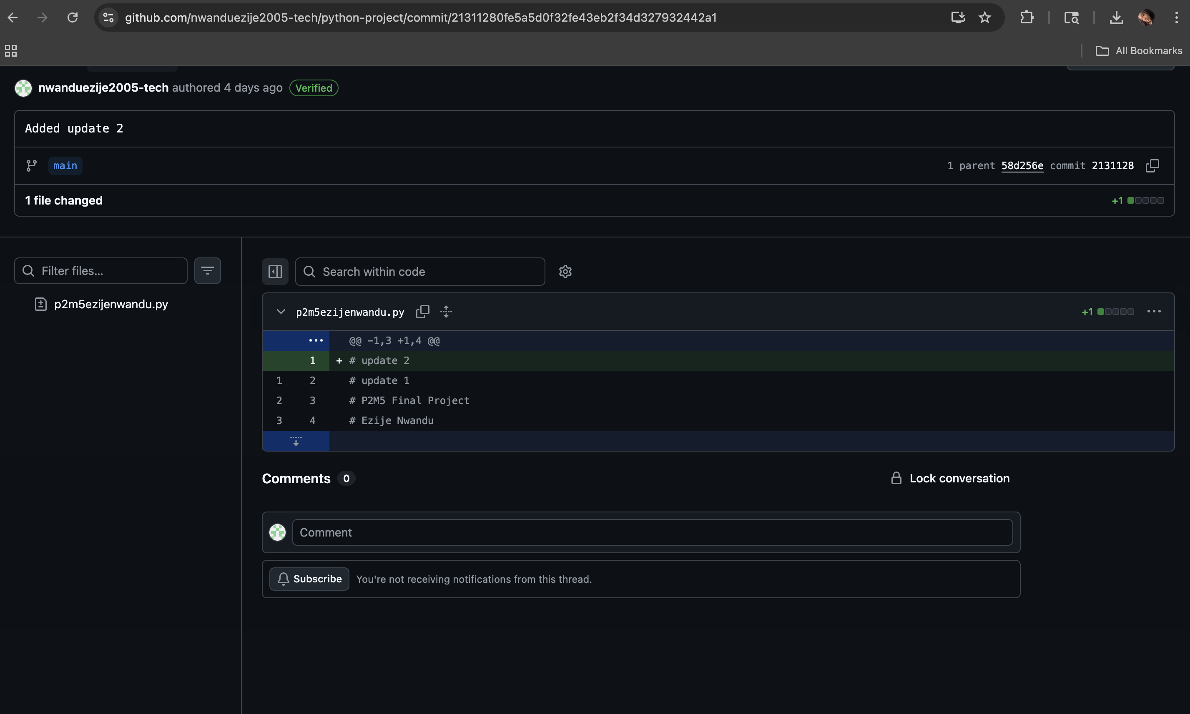
SmartPlate
Ezije Nwandu
GitHub: https://github.com/nwanduezije2005-tech/smartplate
A Python-based system that automates plate tracking, billing, and ordering for conveyor belt sushi restaurants.
Notes:
Tracks plates automatically using QR/RFID
Shows live total cost to customers
Allows digital food ordering

